Slide 1
Cysteine Prediction in Pea Cultivars Using Raman Spectroscopy and Machine Learning Week – 3
Priyanshu Mittal
June 24, 2026

Slide 2
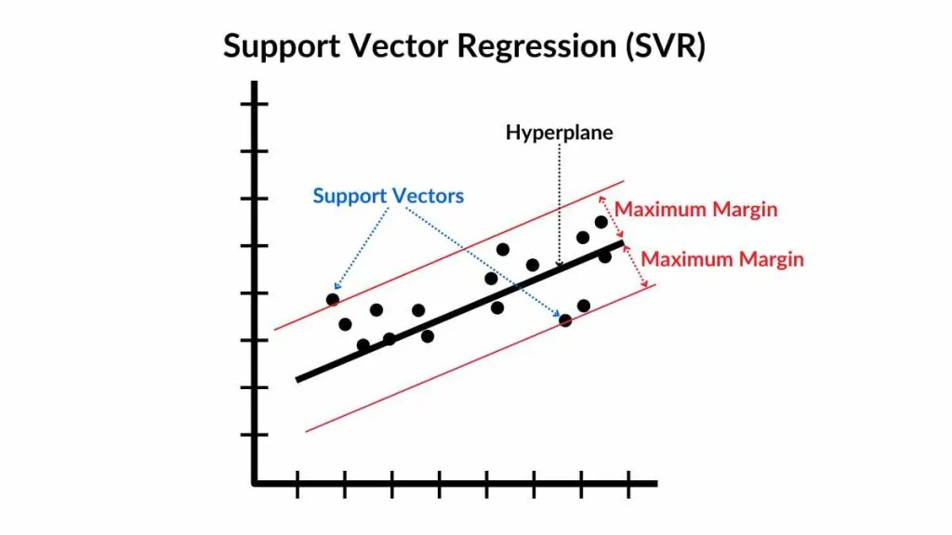
Support Vector Regression
Support Vector Regression (SVR) is a machine learning technique for regression tasks. It extends the principles of Support Vector Machines (SVM) from classification to regression.
In SVR, the goal is to predict continuous target variables rather than discrete classes.
SVR works by finding a hyperplane (or hyperplanes in high-dimensional space) that best fits the training data while also maintaining a maximum margin, where the margin is defined as the distance between the hyperplane and the support vectors.

Slide 3
Support Vector Regression
SVR fits a prediction function within an epsilon error margin, where small errors are ignored.
Only samples outside the epsilon margin contribute to model training and influence the prediction function.
The RBF kernel transforms spectral data into a higher dimensional space, enabling the model to capture complex nonlinear relationships.
This allows SVR to model spectral patterns associated with cysteine concentration more effectively than linear methods such as PLSR.

Slide 4
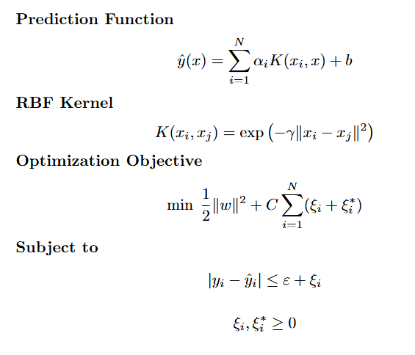
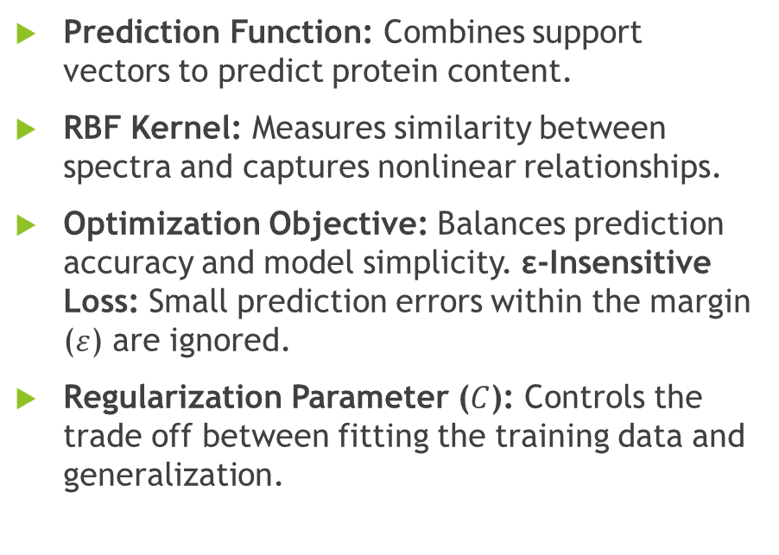
Support Vector Regression – Mathematical Formula
Prediction Function: Combines support vectors to predict protein content.
RBF Kernel: Measures similarity between spectra and captures nonlinear relationships.
Optimization Objective: Balances prediction accuracy and model simplicity. ε-Insensitive Loss: Small prediction errors within the margin ($ε$) are ignored.
Regularization Parameter ($C$): Controls the trade off between fitting the training data and generalization.

Slide 5
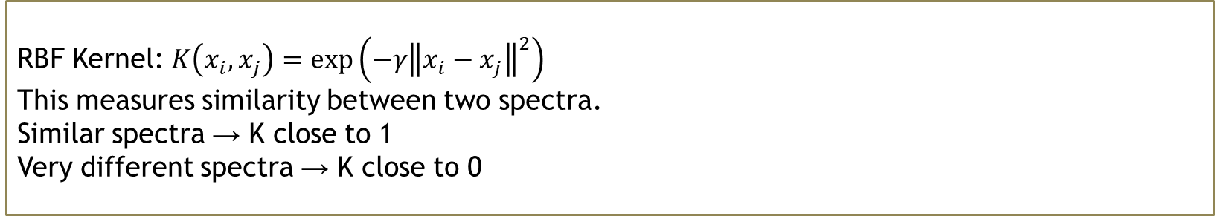
How It Works?
PLSR assumes a straight-line relationship between spectrum and cysteine. But what if the relationship is curved or complex?
Answer: SVR handles this by finding a flexible fit that can bend to match non-linear patterns PLSR completely misses.
The Tube Idea:
The Kernel Trick:
Inside tube → no penalty
Outside tube → penalised by parameter C
Tube width → controlled by epsilon
RBF Kernel: $K\left(x_{i},x_{j}\right)=\exp\left(−γ{\left\|x_{i}−x_{j}\right\|}^{2}\right)$
This measures similarity between two spectra.
Similar spectra → K close to 1
Very different spectra → K close to 0
Notes:
Step 1: The tube idea: Instead of fitting a line through the data, SVR fits a tube around the data. Any spectrum whose prediction falls inside the tube is considered correct. Only predictions outside the tube are penalised. This makes SVR more robust to noisy spectra.
Step 2: The kernel trick: Our spectra have 1,530 features : the relationship between spectrum and cysteine is too complex for a straight line even with a tube. The RBF kernel secretly transforms each spectrum into a much higher-dimensional space where a linear fit suddenly works.

Slide 6
Step by Step in Coding
Preprocess and Scale:
Find best hyperparameters:
SG Smoothing : remove noise
SNV : fix intensity differences between spectra
StandardScaler : centre each wavelength across all 6,480 spectra (different from SNV which normalises each spectrum)
GridSearchCV tests 24 combinations:
C = [0.1, 1, 10, 100]
epsilon = [0.001, 0.01, 0.1]
gamma = ['scale', 'auto']
5-fold CV on training set for each combination
Winner: C=100, epsilon=0.001, gamma=auto
CV RMSE = 0.00557

Slide 7
Step by Step in Coding
Train SVR
LOCOCV
Evaluate
svr = SVR(kernel='rbf', C=100, epsilon=0.001, gamma='auto')
svr.fit(X_train_scaled, y_train)
For each fold:
Fit StandardScaler on TRAINING fold only
Transform both train and test with that scaler
# Never fit scaler on test data (This prevents data leakage between folds)
80/20 Split → quick evaluation, optimistic
LOCOCV → realistic evaluation, harder

Slide 8
Why SVR for spectral data:
Handles high dimensional spectral data effectively, even with 1,530 features.
RBF kernel captures complex nonlinear relationships between spectra and protein content.
Robust to overfitting through the epsilon insensitive error margin.
Requires feature standardization using StandardScaler before model training.
Uses only the most informative samples (support vectors) for prediction.

Slide 9
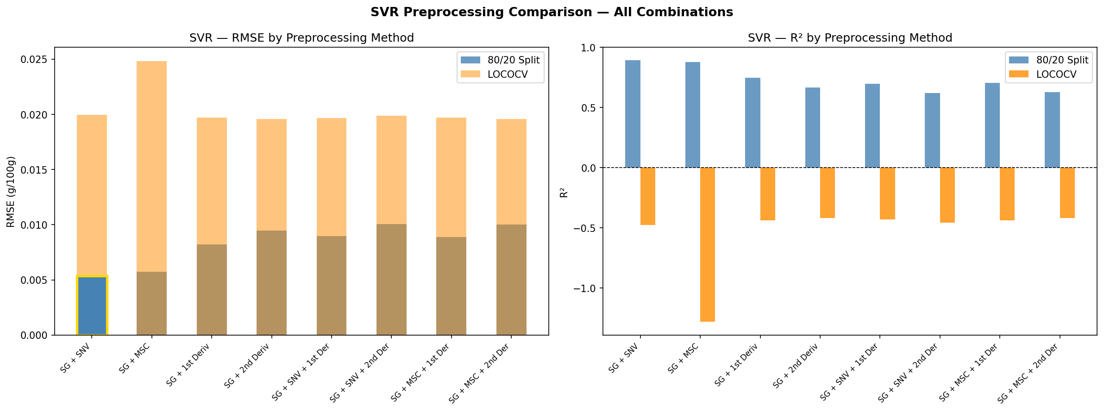
SVR Preprocessing Comparison
G + SNV wins on 80/20 (RMSE=0.0053, R²=0.89, RPD=3.06)
Derivatives perform similarly under LOCO (~0.0196–0.0200)
All methods cluster around RMSE ~0.020 under LOCO

Slide 10
SVR Preprocessing Comparison
Preprocessing Method | RMSE (80/20) | R² (80/20) | RPD (80/20) | RMSE (LOCO) | R² (LOCO) | RPD (LOCO)
SG + SNV | 0.0053 | 0.8935 | 3.0644 | 0.0200 | -0.4750 | 0.8234
SG + MSC | 0.0057 | 0.8783 | 2.8660 | 0.0248 | -1.2826 | 0.6619
SG + 1st Derivative | 0.0082 | 0.7490 | 1.9960 | 0.0197 | -0.4364 | 0.8344
SG + 2nd Derivative | 0.0095 | 0.6667 | 1.7320 | 0.0196 | -0.4191 | 0.8395
SG + SNV + 1st Derivative | 0.0090 | 0.6996 | 1.8246 | 0.0197 | -0.4314 | 0.8358
SG + SNV + 2nd Derivative | 0.0101 | 0.6216 | 1.6256 | 0.0199 | -0.4579 | 0.8282
SG + MSC + 1st Derivative | 0.0089 | 0.7064 | 1.8455 | 0.0197 | -0.4364 | 0.8344
SG + MSC + 2nd Derivative | 0.0100 | 0.6270 | 1.6374 | 0.0196 | -0.4191 | 0.8395

Slide 11
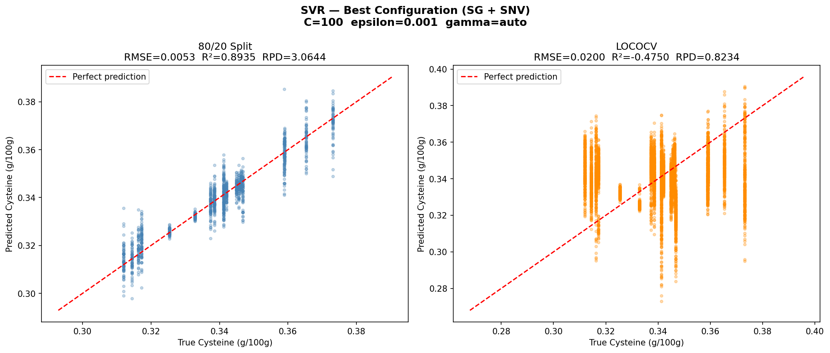
SVR Best Configuration Results

Slide 12
SVR Best Configuration Results
 | 80/20 Split | LOCOCV
RMSE | 0.0053 | 0.0200
R² | 0.8935 | -0.4750
RPD | 3.0644 | 0.8234
Best preprocessing | SG + SNV | SG + SNV
C / ε / γ | 100 / 0.001 / auto | 100 / 0.001 / auto
80/20 R² = 0.89 and RPD = 3.06
First model to cross the RPD > 3.0 screening threshold
LOCO still shows negative R²
SVR memorises cultivar-specific patterns rather than learning the true cysteine signal

Slide 13
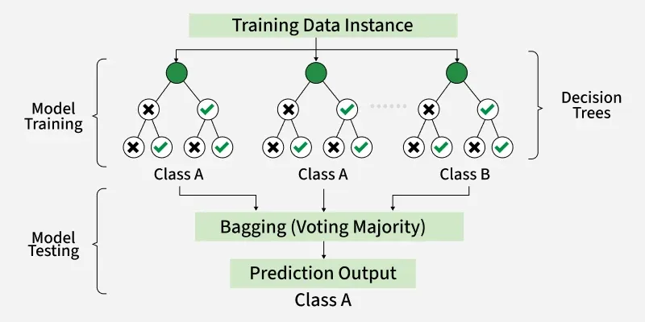
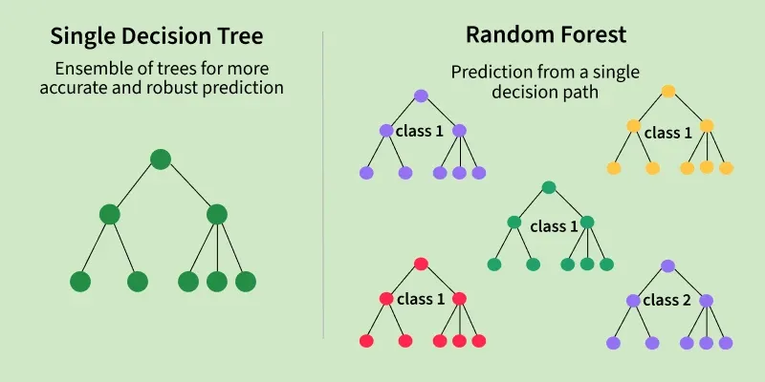
Random Forest Regression
Random Forest is a machine learning algorithm that uses many decision trees to make better predictions.
Each tree looks at different random parts of the data and their results are combined by voting for classification or averaging for regression which makes it as ensemble learning technique.
This helps in improving accuracy and reducing errors.

Slide 14
Random Forest Regression
Builds 200 decision trees using random bootstrap samples of the training data.
At each node split, only a random subset of features is considered (√1530 ≈ 39 features).
Each tree generates an individual prediction for protein content.
The final prediction is obtained by averaging the predictions from all 200 trees.
Random feature selection and bootstrapping help reduce overfitting.
Combining many trees lowers prediction variance compared to a single decision tree.
The ensemble approach makes the model robust to noise and variability in NIR spectral data.

Slide 15
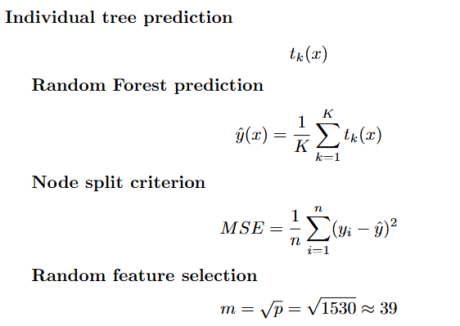
Random Forest Regression – Mathematical Formula
Individual Tree Prediction : Each decision tree predicts cysteine content independently.
Random Forest Prediction : Final prediction is the average of all 200 tree predictions.
Node Split Criterion (MSE): Trees select splits that minimize prediction error within each node.
Random Feature Selection: Only 39 randomly selected wavelengths are evaluated at each split, increasing model diversity and reducing overfitting.

Slide 16
Why Random Forest for spectral data:
No feature scaling required since decision trees are unaffected by feature magnitude.
Captures complex nonlinear relationships and interactions among spectral features.
Provides built in feature importance to identify the most influential wavelengths.
Robust to outliers and noisy spectra through ensemble averaging.
Efficient training using parallel processing with n_jobs = -1.

Slide 17
How it Works:
Imagine asking 200 different experts to independently predict cysteine concentration. Each expert only sees a random portion of the data and only considers a random subset of wavelengths. Then you average all 200 answers. No single expert is perfect — but together they are much more reliable. That is exactly what Random Forest does.
Bootstrap Sampling
Random feature selection at each split:
Tree 1 sees: spectra 1, 1, 3, 5, 7, 7, 9 ... (random sample with replacement)
Tree 2 sees: spectra 2, 4, 4, 6, 8, 9, 9 ... (different random sample)
Tree 3 sees: spectra 1, 3, 5, 5, 6, 8, 9 ... (yet another sample)
Without random features → all trees look identical → averaging does nothing
With random features → trees are diverse → averaging reduces error
Notes:
Step 1: Each of the 200 trees sees a different random sample of the 6,480 spectra with replacement. This means some spectra appear multiple times in one tree's training data and not at all in another’s.
Step 2: At every node split, instead of considering all 1,530 wavelengths, each tree randomly picks only √1530 ≈ 39 wavelengths to consider. This forces trees to be different from each other.

Slide 18
How it works?
Growing each tree
Final Prediction
Is intensity at 643 cm⁻¹ > 250?
Yes : Is intensity at 712 cm⁻¹ > 180?
Yes : predict 0.365
No : predict 0.341
No : Is intensity at 891 cm⁻¹ > 420?
Yes : predict 0.328
No : predict 0.312
Tree 1 predicts: 0.342
Tree 2 predicts: 0.338
Tree 3 predicts: 0.351
...
Tree 200 predicts: 0.344
Final answer = average of all 200 = 0.344 g/100g
Notes:
Step 3: Each tree asks a series of questions about the spectrum:
Trees keep splitting until groups are as pure as possible measured by MSE.

Slide 19
Step by Step Coding
Preprocessing: (No scaling required)
Find Best hyperparameters
SG Smoothing : remove noise
SNV : fix intensity differences
No StandardScaler needed : RF is scale-invariant
RandomizedSearchCV tests 20 random combinations from:
n_estimators = [100, 200, 300]
max_depth = [5, 10, 20, None]
min_samples_split = [2, 5, 10]
min_samples_leaf = [1, 2, 4]
max_features = ['sqrt', 'log2']
Winner:
n_estimators = 200 # 200 trees
max_depth = None # trees grow fully
max_features = sqrt # 39 features per split
CV RMSE = 0.00747

Slide 20
Step by Step Coding
Train Random Forest:
LOCOCV – no scaler needed for fold:
rf = RandomForestRegressor(n_estimators=200,
max_depth=None,
max_features='sqrt',
n_jobs=-1)
rf.fit(X_train, y_train)
n_jobs=-1
#uses all CPU cores simultaneously (this is why RF is much faster than SVR)
For each fold:
Train RF on 19 cultivars
Predict held-out cultivar
No scaling step needed # simpler than SVR

Slide 21
Step by Step Coding
Finding in Preprocessing
Best 80/20 preprocessing → SG + SNV (same as PLSR and SVR)
Best LOCO preprocessing → SG + 2nd Deriv (different!)
2nd derivative helps RF generalise to unseen cultivars
by removing baseline effects that vary between cultivars

Slide 22
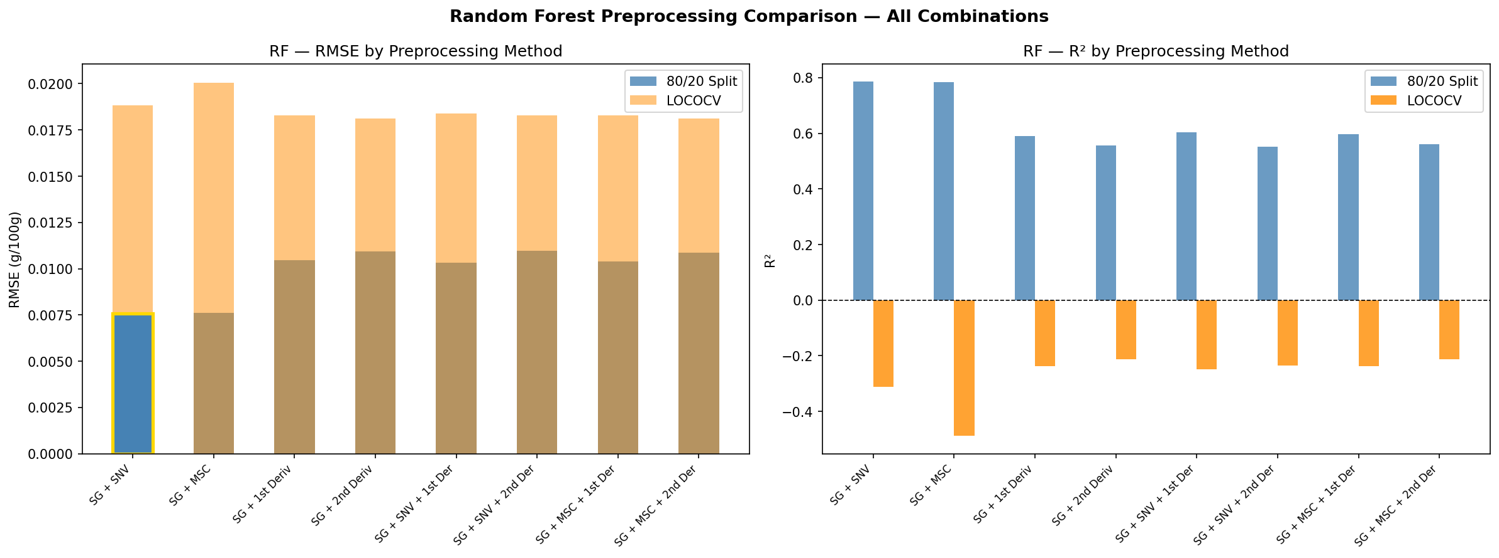
Random Forest Preprocessing Comparison
SG + SNV best for 80/20 as consistent with PLSR and SVR
SG + 2nd Derivative best for LOCO as derivatives help RF generalise to unseen cultivars unlike PLSR and SVR

Slide 23
Random Forest Preprocessing Comparison
Preprocessing Method | RMSE (80/20) | R² (80/20) | RPD (80/20) | RMSE (LOCO) | R² (LOCO) | RPD (LOCO)
SG + SNV | 0.0076 | 0.7857 | 2.1604 | 0.0188 | -0.3117 | 0.8731
SG + MSC | 0.0076 | 0.7832 | 2.1478 | 0.0201 | -0.4885 | 0.8196
SG + 1st Derivative | 0.0105 | 0.5911 | 1.5638 | 0.0183 | -0.2381 | 0.8987
SG + 2nd Derivative | 0.0109 | 0.5552 | 1.4995 | 0.0181 | -0.2117 | 0.9085
SG + SNV + 1st Derivative | 0.0103 | 0.6029 | 1.5869 | 0.0184 | -0.2484 | 0.8950
SG + SNV + 2nd Derivative | 0.0110 | 0.5524 | 1.4948 | 0.0183 | -0.2356 | 0.8996
SG + MSC + 1st Derivative | 0.0104 | 0.5970 | 1.5753 | 0.0183 | -0.2381 | 0.8987
SG + MSC + 2nd Derivative | 0.0109 | 0.5608 | 1.5090 | 0.0181 | -0.2117 | 0.9085

Slide 24
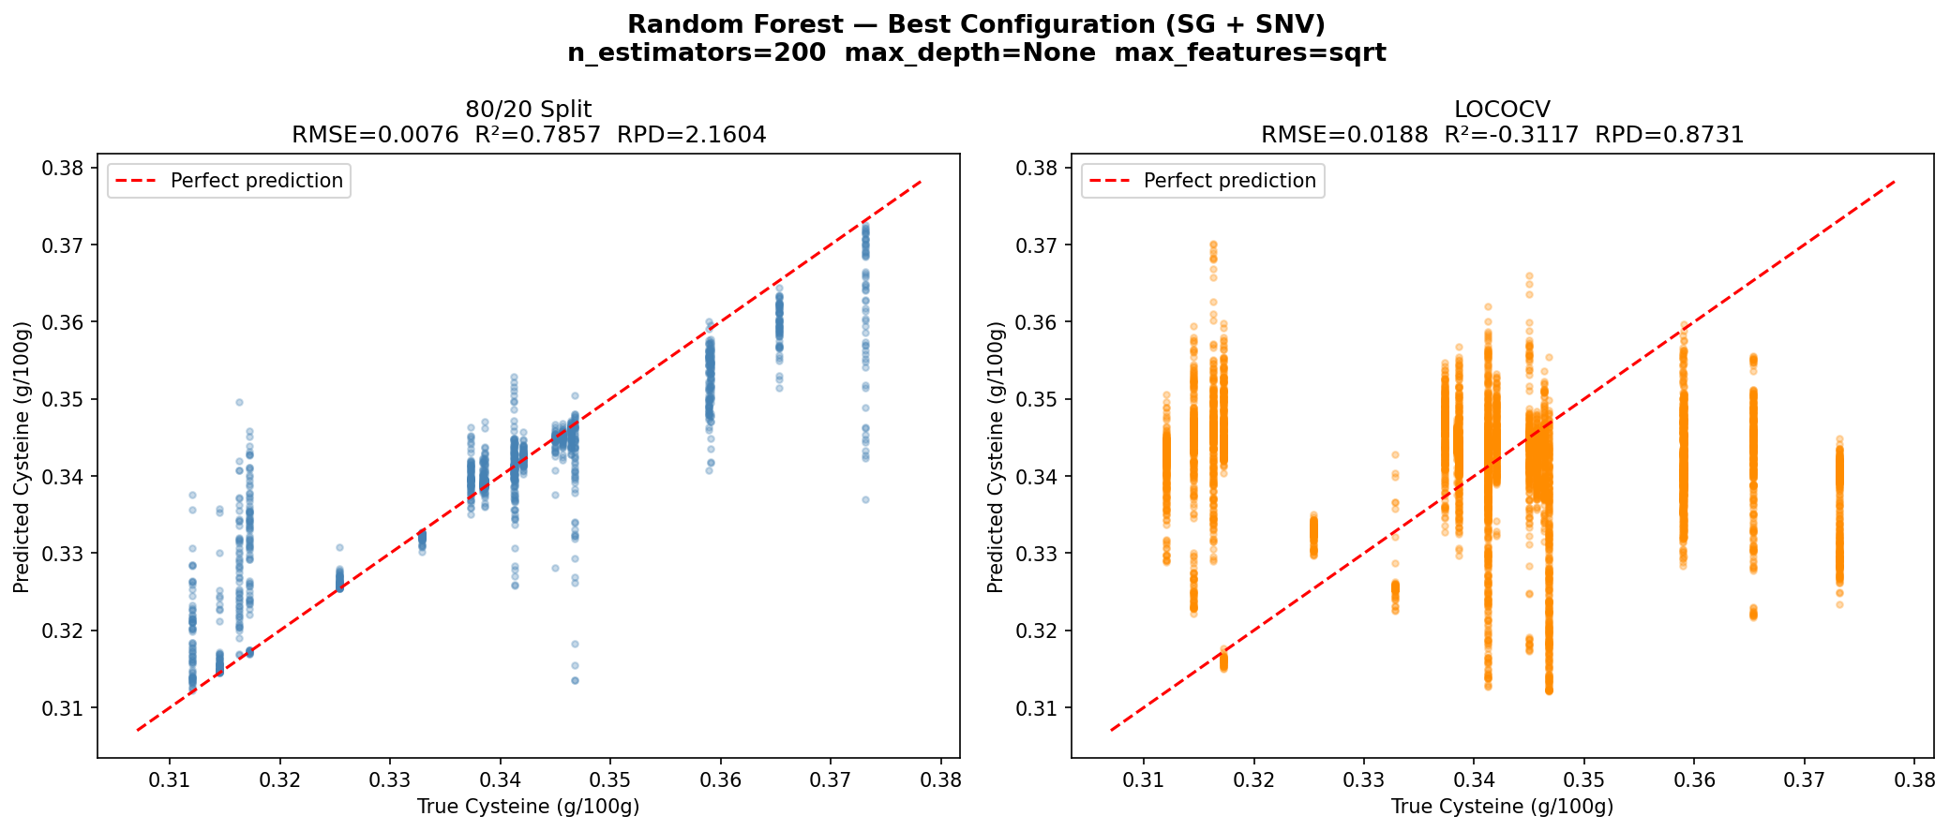
Random Forest Best Configuration Results

Slide 25
Random Forest Best Configuration Results
Metric | 80/20 Split | LOCOCV
RMSE | 0.0076 | 0.0188
R² | 0.7857 | -0.3117
RPD | 2.1604 | 0.8731
Preprocessing | SG + SNV | SG + SNV
n_estimators | 200 | 200
max_depth | None | None
max_features | sqrt | sqrt
Best LOCO R² of all three models so far (-0.31 vs SVR -0.47 vs PLSR -0.65)
Best LOCO RPD = 0.87

Slide 26
PLSR vs SVR vs Random Forest
Metric | PLSR | SVR | RF
80/20 RMSE | 0.0122 | 0.0053 | 0.0076
80/20 R² | 0.4476 | 0.8935 | 0.7857
80/20 RPD | 1.3455 | 3.0644 | 2.1604
LOCO RMSE | 0.0211 | 0.0200 | 0.0188
LOCO R² | -0.6481 | -0.4750 | -0.3117
LOCO RPD | 0.7790 | 0.8234 | 0.8731
Best Preprocessing | SG + SNV | SG + SNV | SG + SNV
SVR achieved the best performance for within cultivar prediction, with an RPD greater than 3.0, making it suitable for screening applications.
RF showed the strongest cross cultivar performance, achieving the lowest LOCO RMSE and highest LOCO RPD.
All models produced negative LOCO R² values, indicating limited generalisation to unseen cultivars.

